Slide 2
Smoothing Algorithms

Slide 3
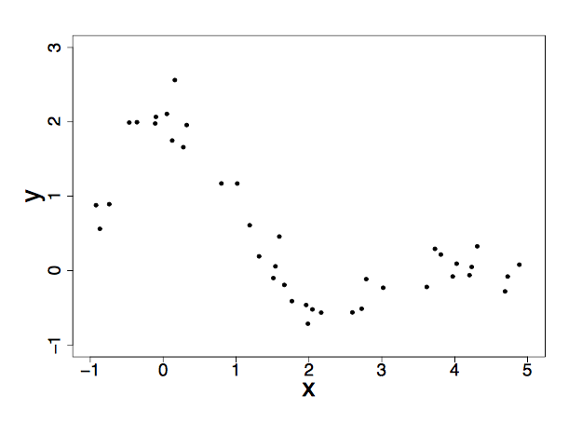
Raw data (before smoothing)

Slide 4
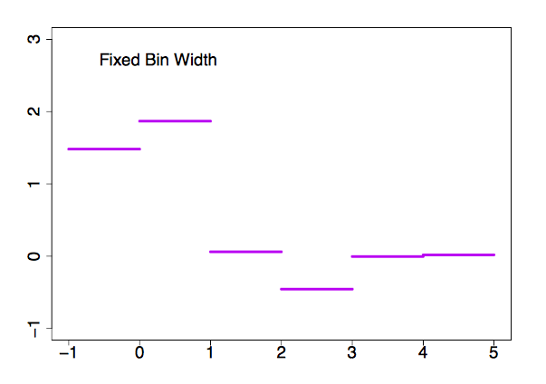
1. Bin Smoothing
A bin smoother cuts your domain into discrete bins of a fixed-width over which an average is computed, which results in equally weighted estimations of Y across its domain.
Limitations: Sometimes it’s inappropriate to weight Y equally across its domain.

Slide 5
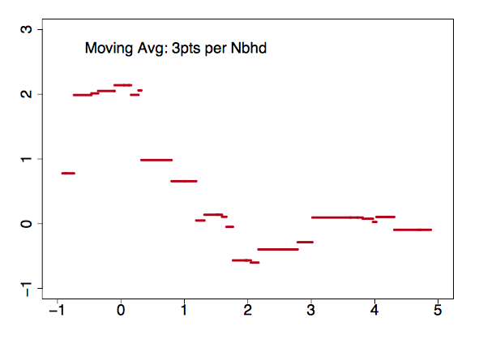
2. Simple Moving Average
Arguably the simplest and most common smoother is the trusted simple moving average, which is similar to bin smoothing, except the mean value is computed over a variable bin-width with a fixed number of observations.
Limitations: Inflexible, reductive near the complexity

Slide 6
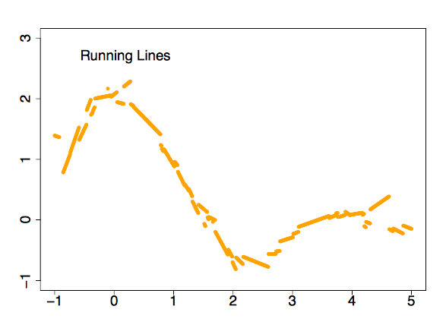
3. Running Line – local or global
Running line smoothers create a smooth that is more flexible and reliable than the simple moving average because it fits a line to Y over the fixed-width rather than a simple average.
Limitations: Inflexible, reductive near complexity.

Slide 7
4. Kernel Density
Like the running line smoothers, kernel density is similar to a moving average, except its average is weighted and has a fixed bin-width.
Limitations: Slow.

Slide 8
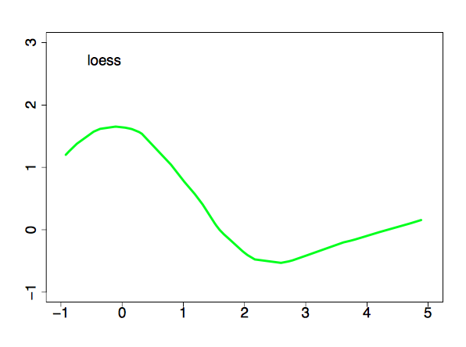
5. LOESS – Locally Estimated Scatterplot Smoother
Loess is the conceptual product of running line and kernel density smoothers. That is, Loess extends the idea of fitting a line over variable bin-widths but it’s a weighted regression line.
Limitations: computationally expensive, but this is an outmoded concern on modern machines, except in rare applications.

Slide 9
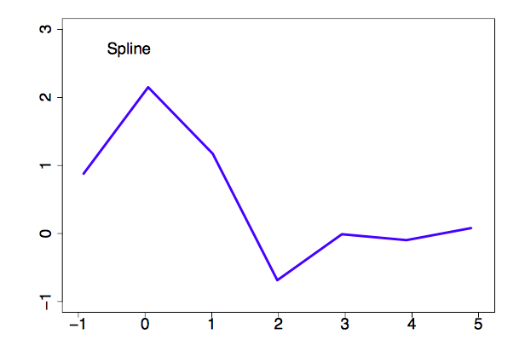
6. Smoothing Splines
The intuition behind smoothing splines is to cut Y’s domain into partitions over which the algorithm computes a spline, which are joined at intersections called knots. These splines are piecewise polynomials that are typically restricted to being smooth at these knots such that the “knotty-ness” is unobservable to the human eye (but need not be).
Limitations: Untenably rough in large samples.

Slide 10
As you can see, these smoothing techniques come in a host of flavors:
Sides. One-sided or two-sided.
Exponent. Exponential or linear.
Weights. Weighted or unweighted.
Bin-width. Fixed or variable.
Observations. Fixed or variable.

